Slide 1
Issues about the 2nd batch HTT competitors and internal compounds
Sep 12, 2022
Zhen, Dann, Catherine, Joon, Magnus, Jessica

Slide 2
Sample similarity from Gene Expression (1st batch)
PCA in 2D for iPSC
PCA in 2D for NGN2

Slide 3
Sample similarity from Gene Expression (2nd batch raw)
PCA in 2D for iPSC
PCA in 2D for NGN2

Slide 4
Sample similarity from Gene Expression (2nd batch raw after removal of low quality samples)
PCA in 2D for iPSC
PCA in 2D for NGN2

Slide 5
Sample similarity from Gene Expression (2nd batch raw after removal of R4)
PCA in 2D for iPSC
PCA in 2D for NGN2

Slide 6
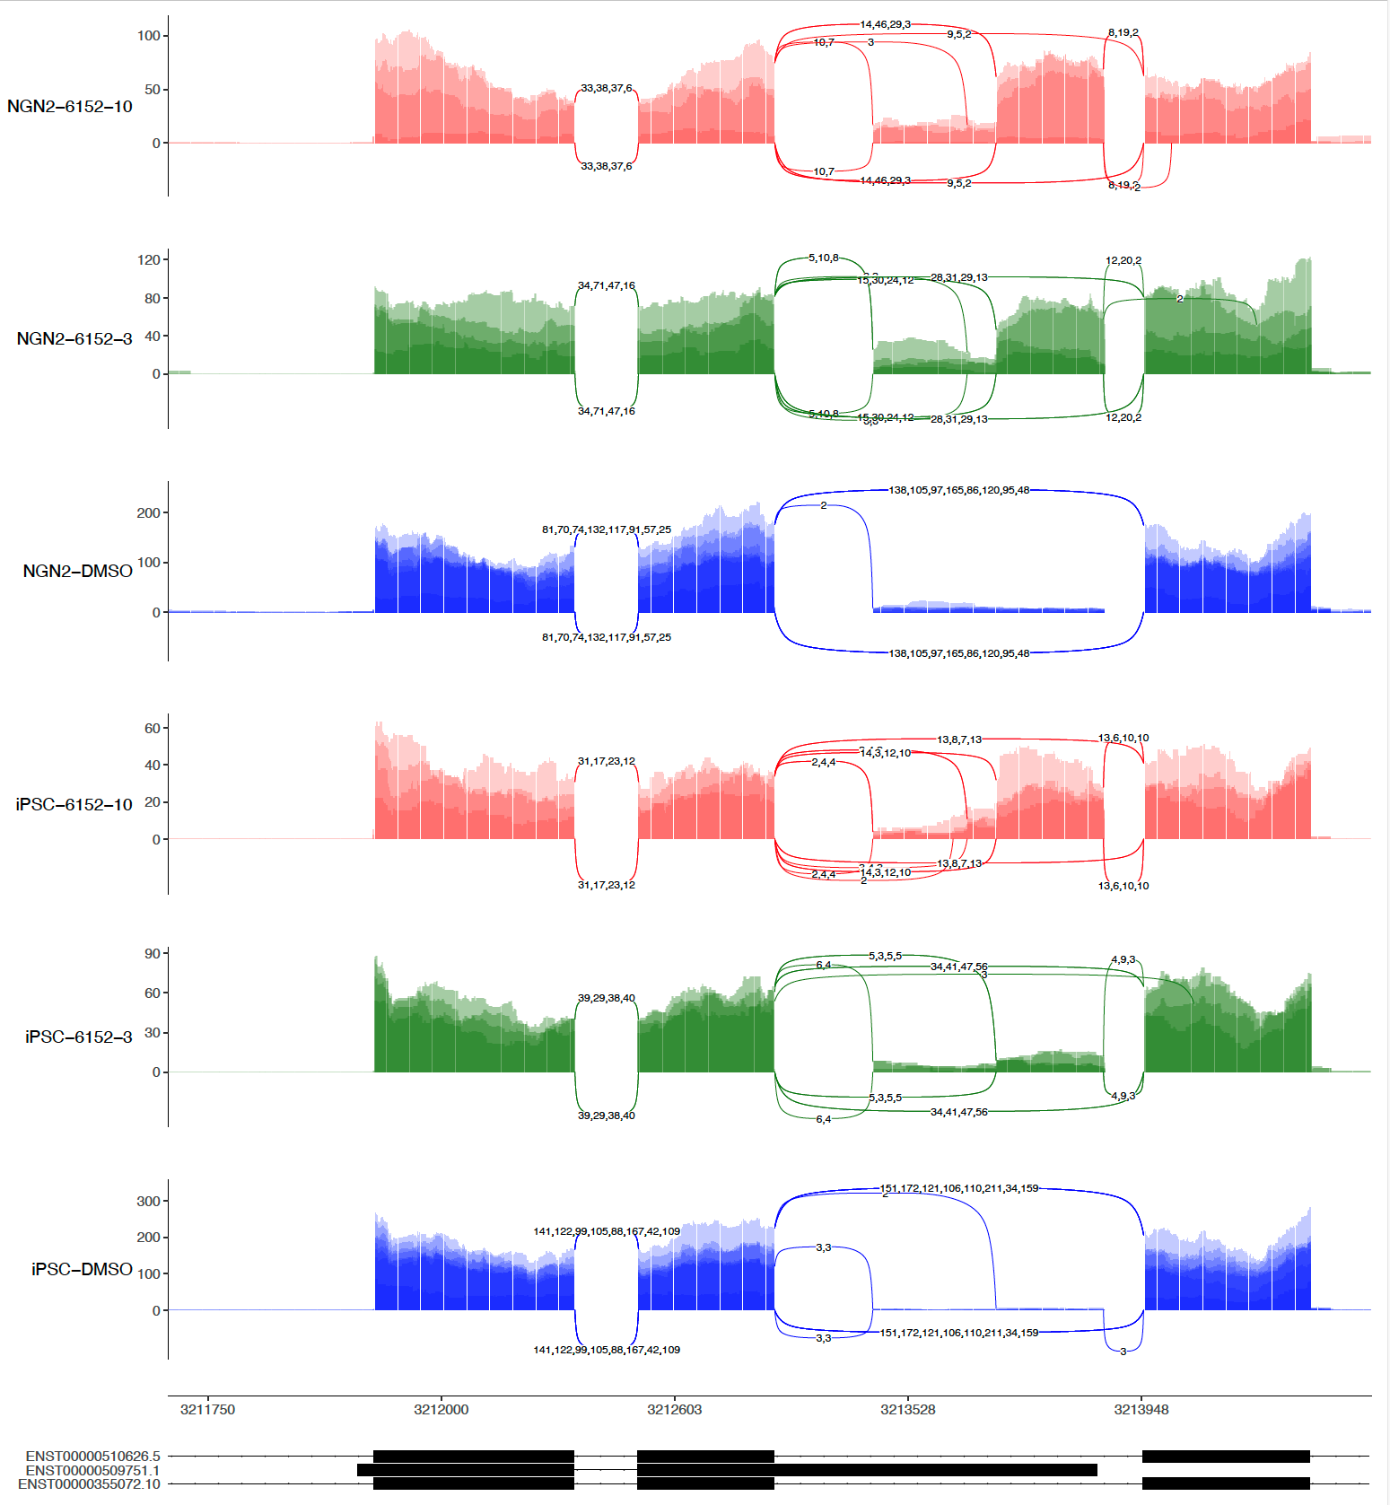
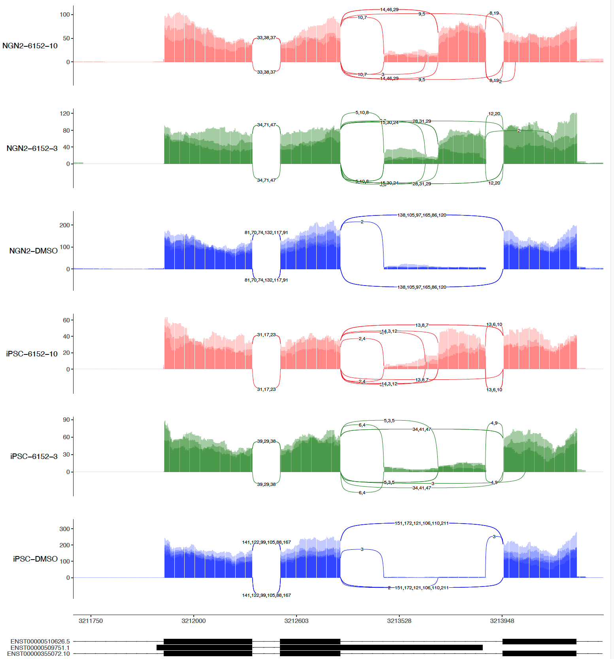
sashimi-plots: 6152
4 repeats
3 repeats (No R4)

Slide 7
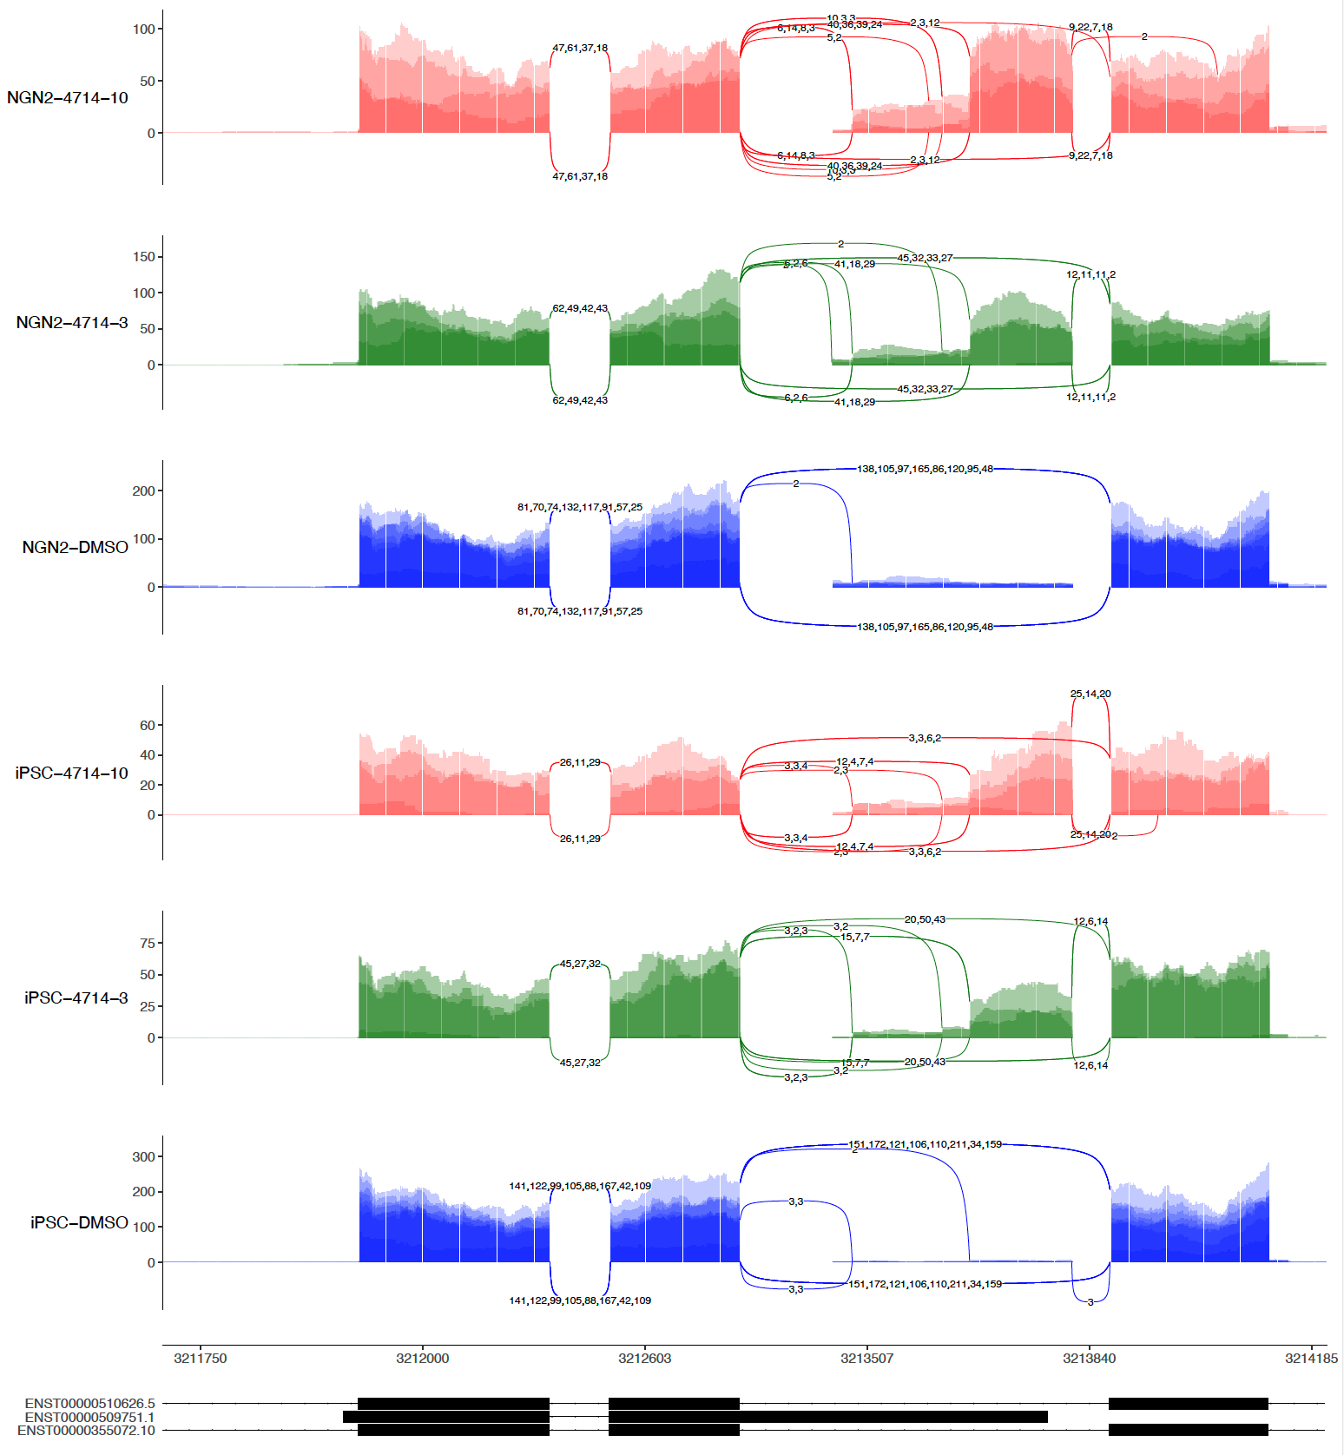
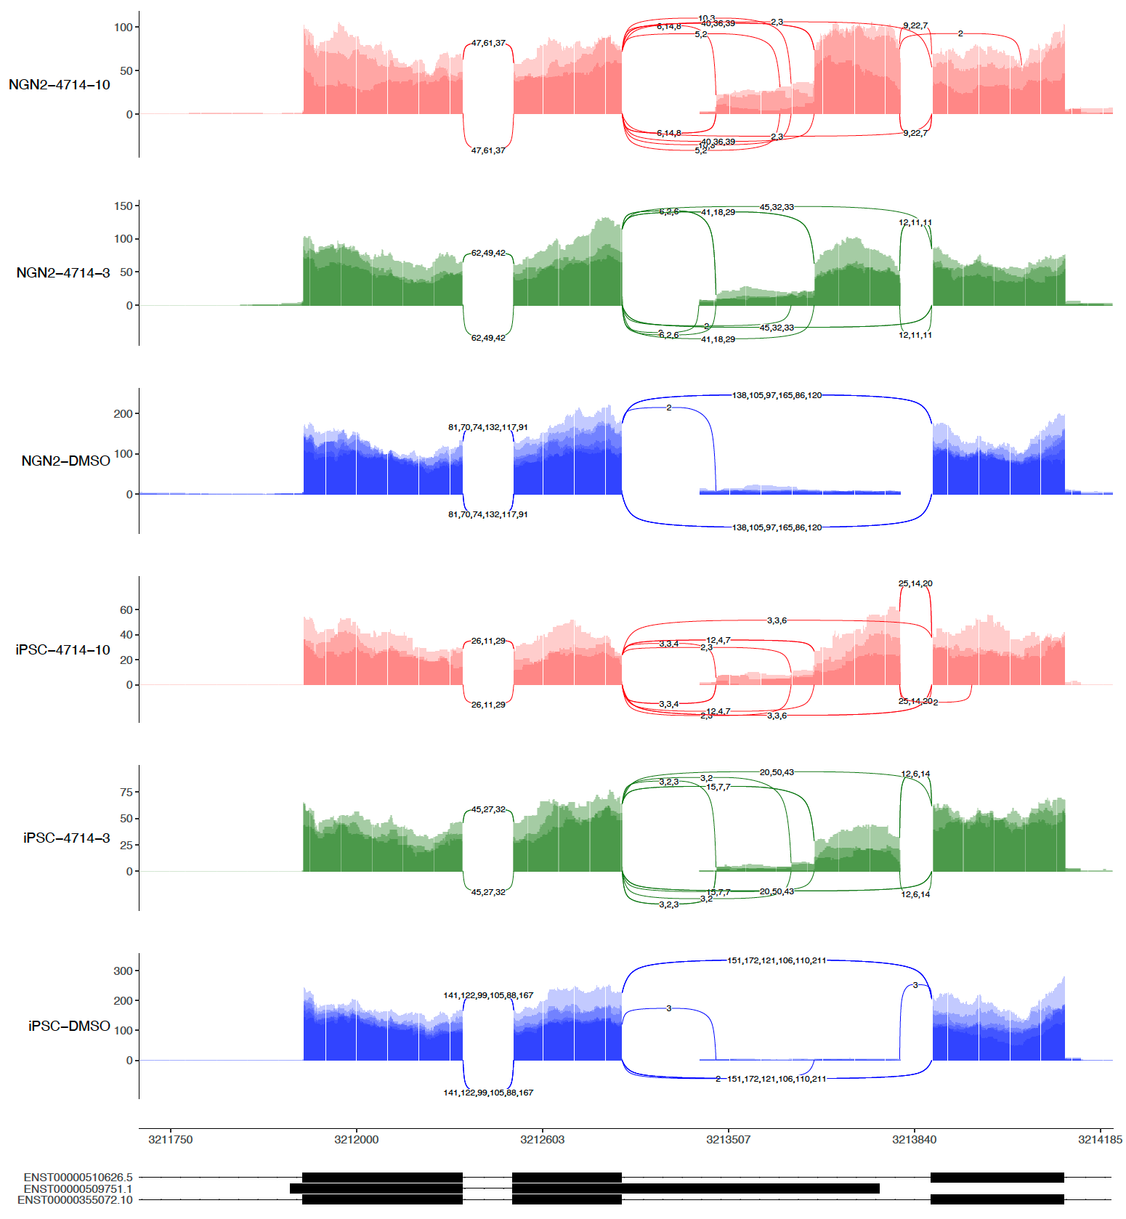
sashimi-plots: 4714
4 repeats
3 repeats (No R4)

Slide 8
Reads statistics, multiQC and sashimi-plots

Slide 9
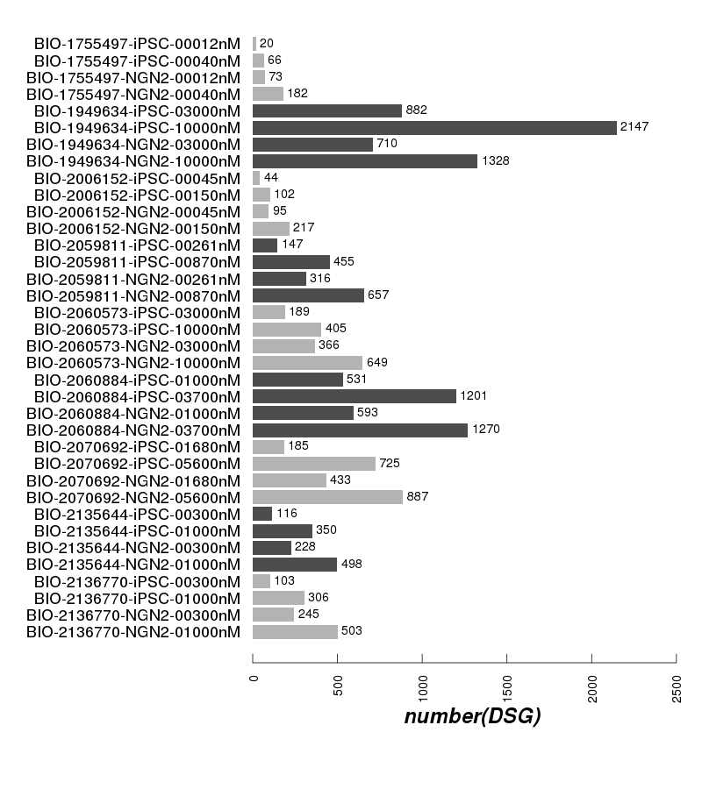
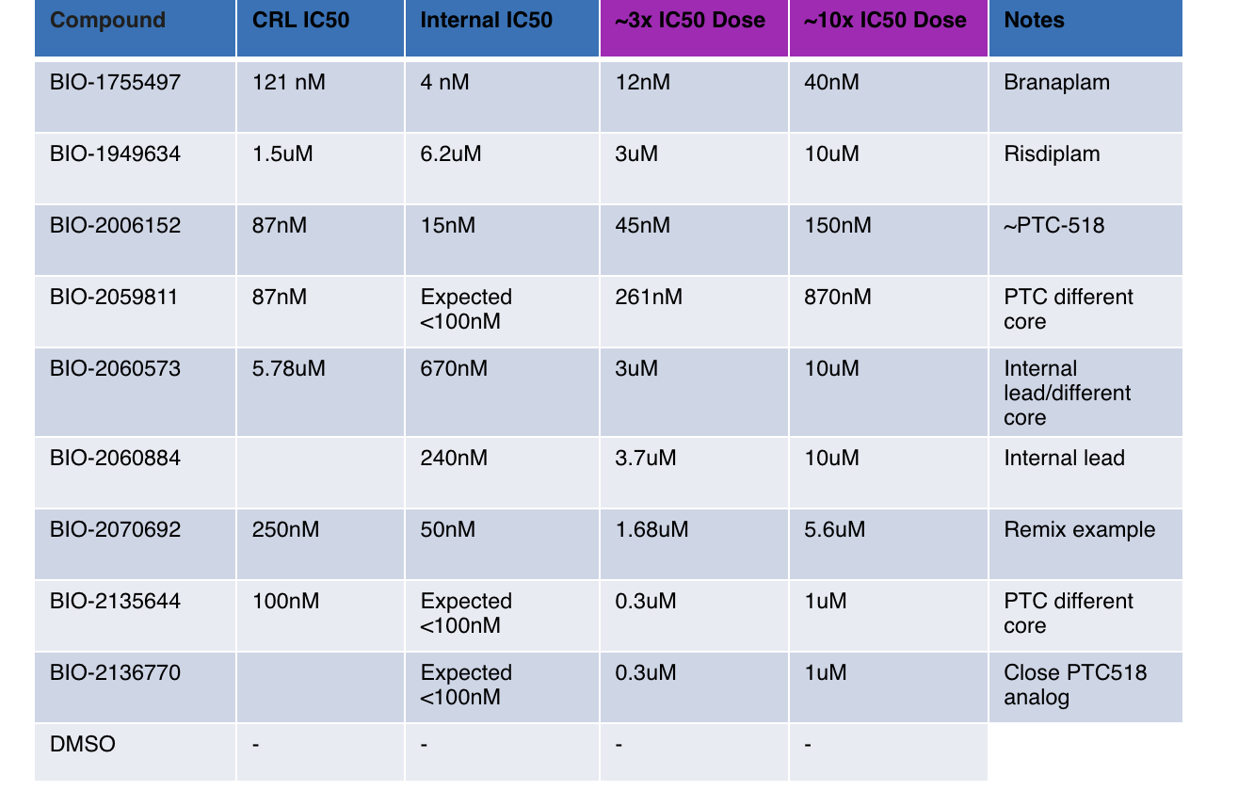
DSG numbers

Slide 10
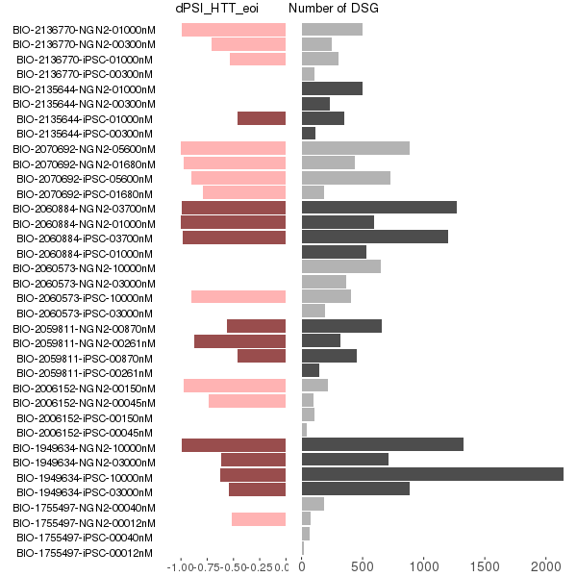
DSG and dPSI in eoi

Slide 11
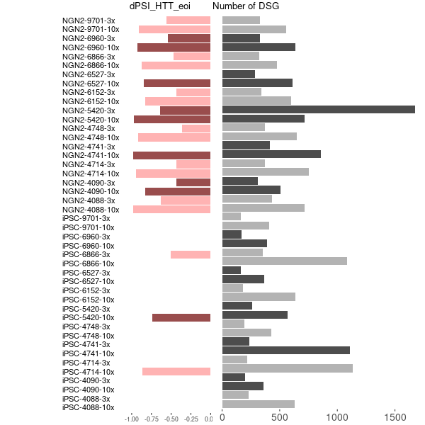
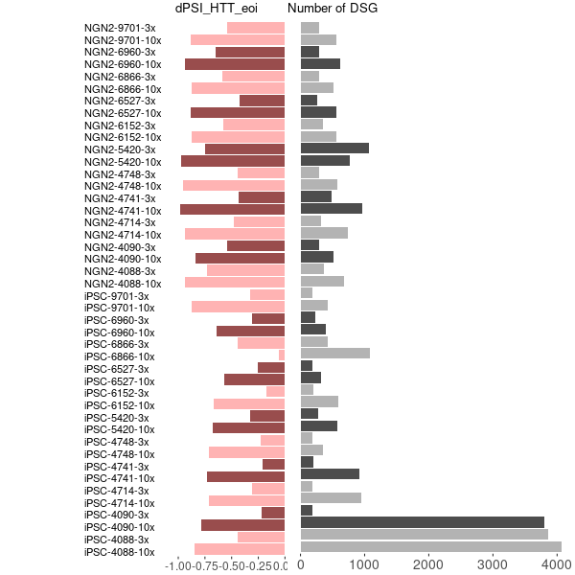
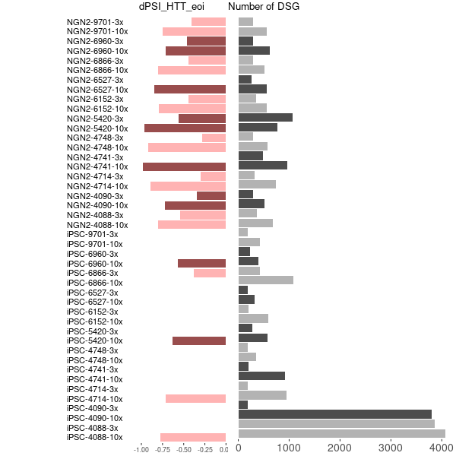
DSG and dPSI in eoi
Updated dPSI from leafcutter
dPSI from majiq
leafcutter majiq merged

Slide 12
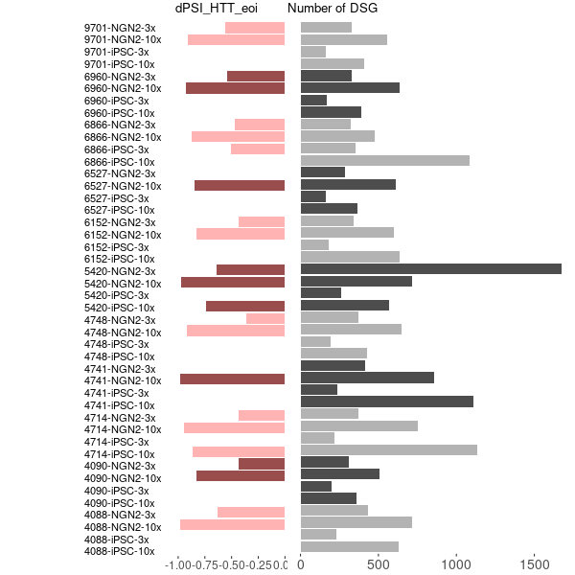
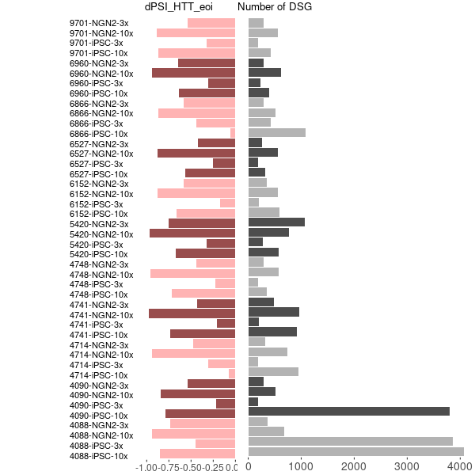
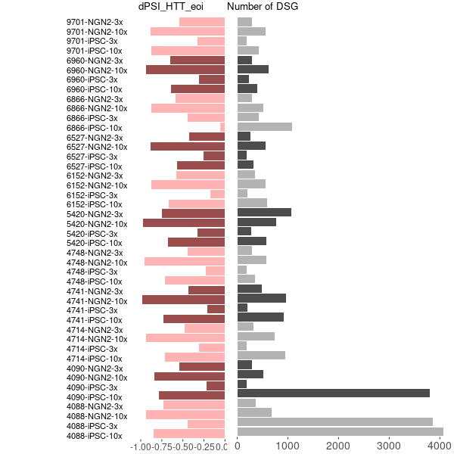
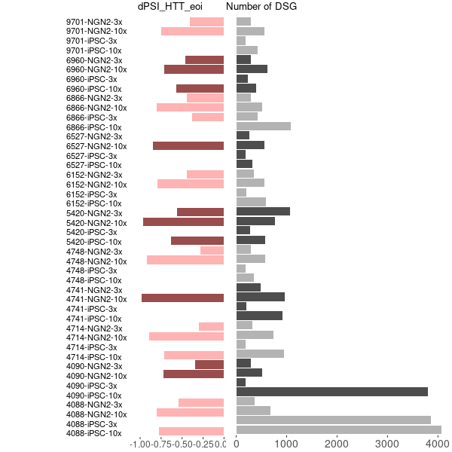
DSG and dPSI in eoi
Updated dPSI from leafcutter
dPSI from majiq
leafcutter majiq merged

Slide 13
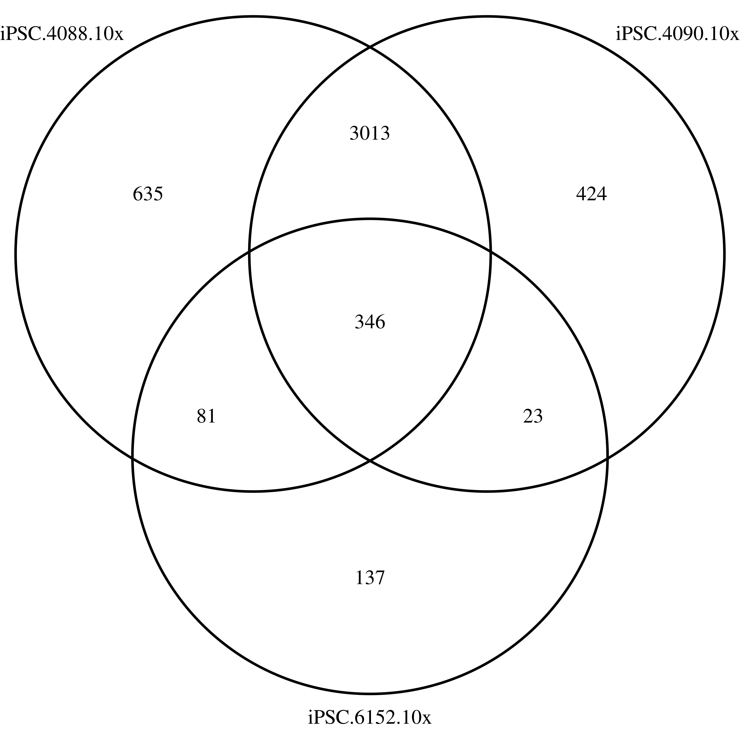
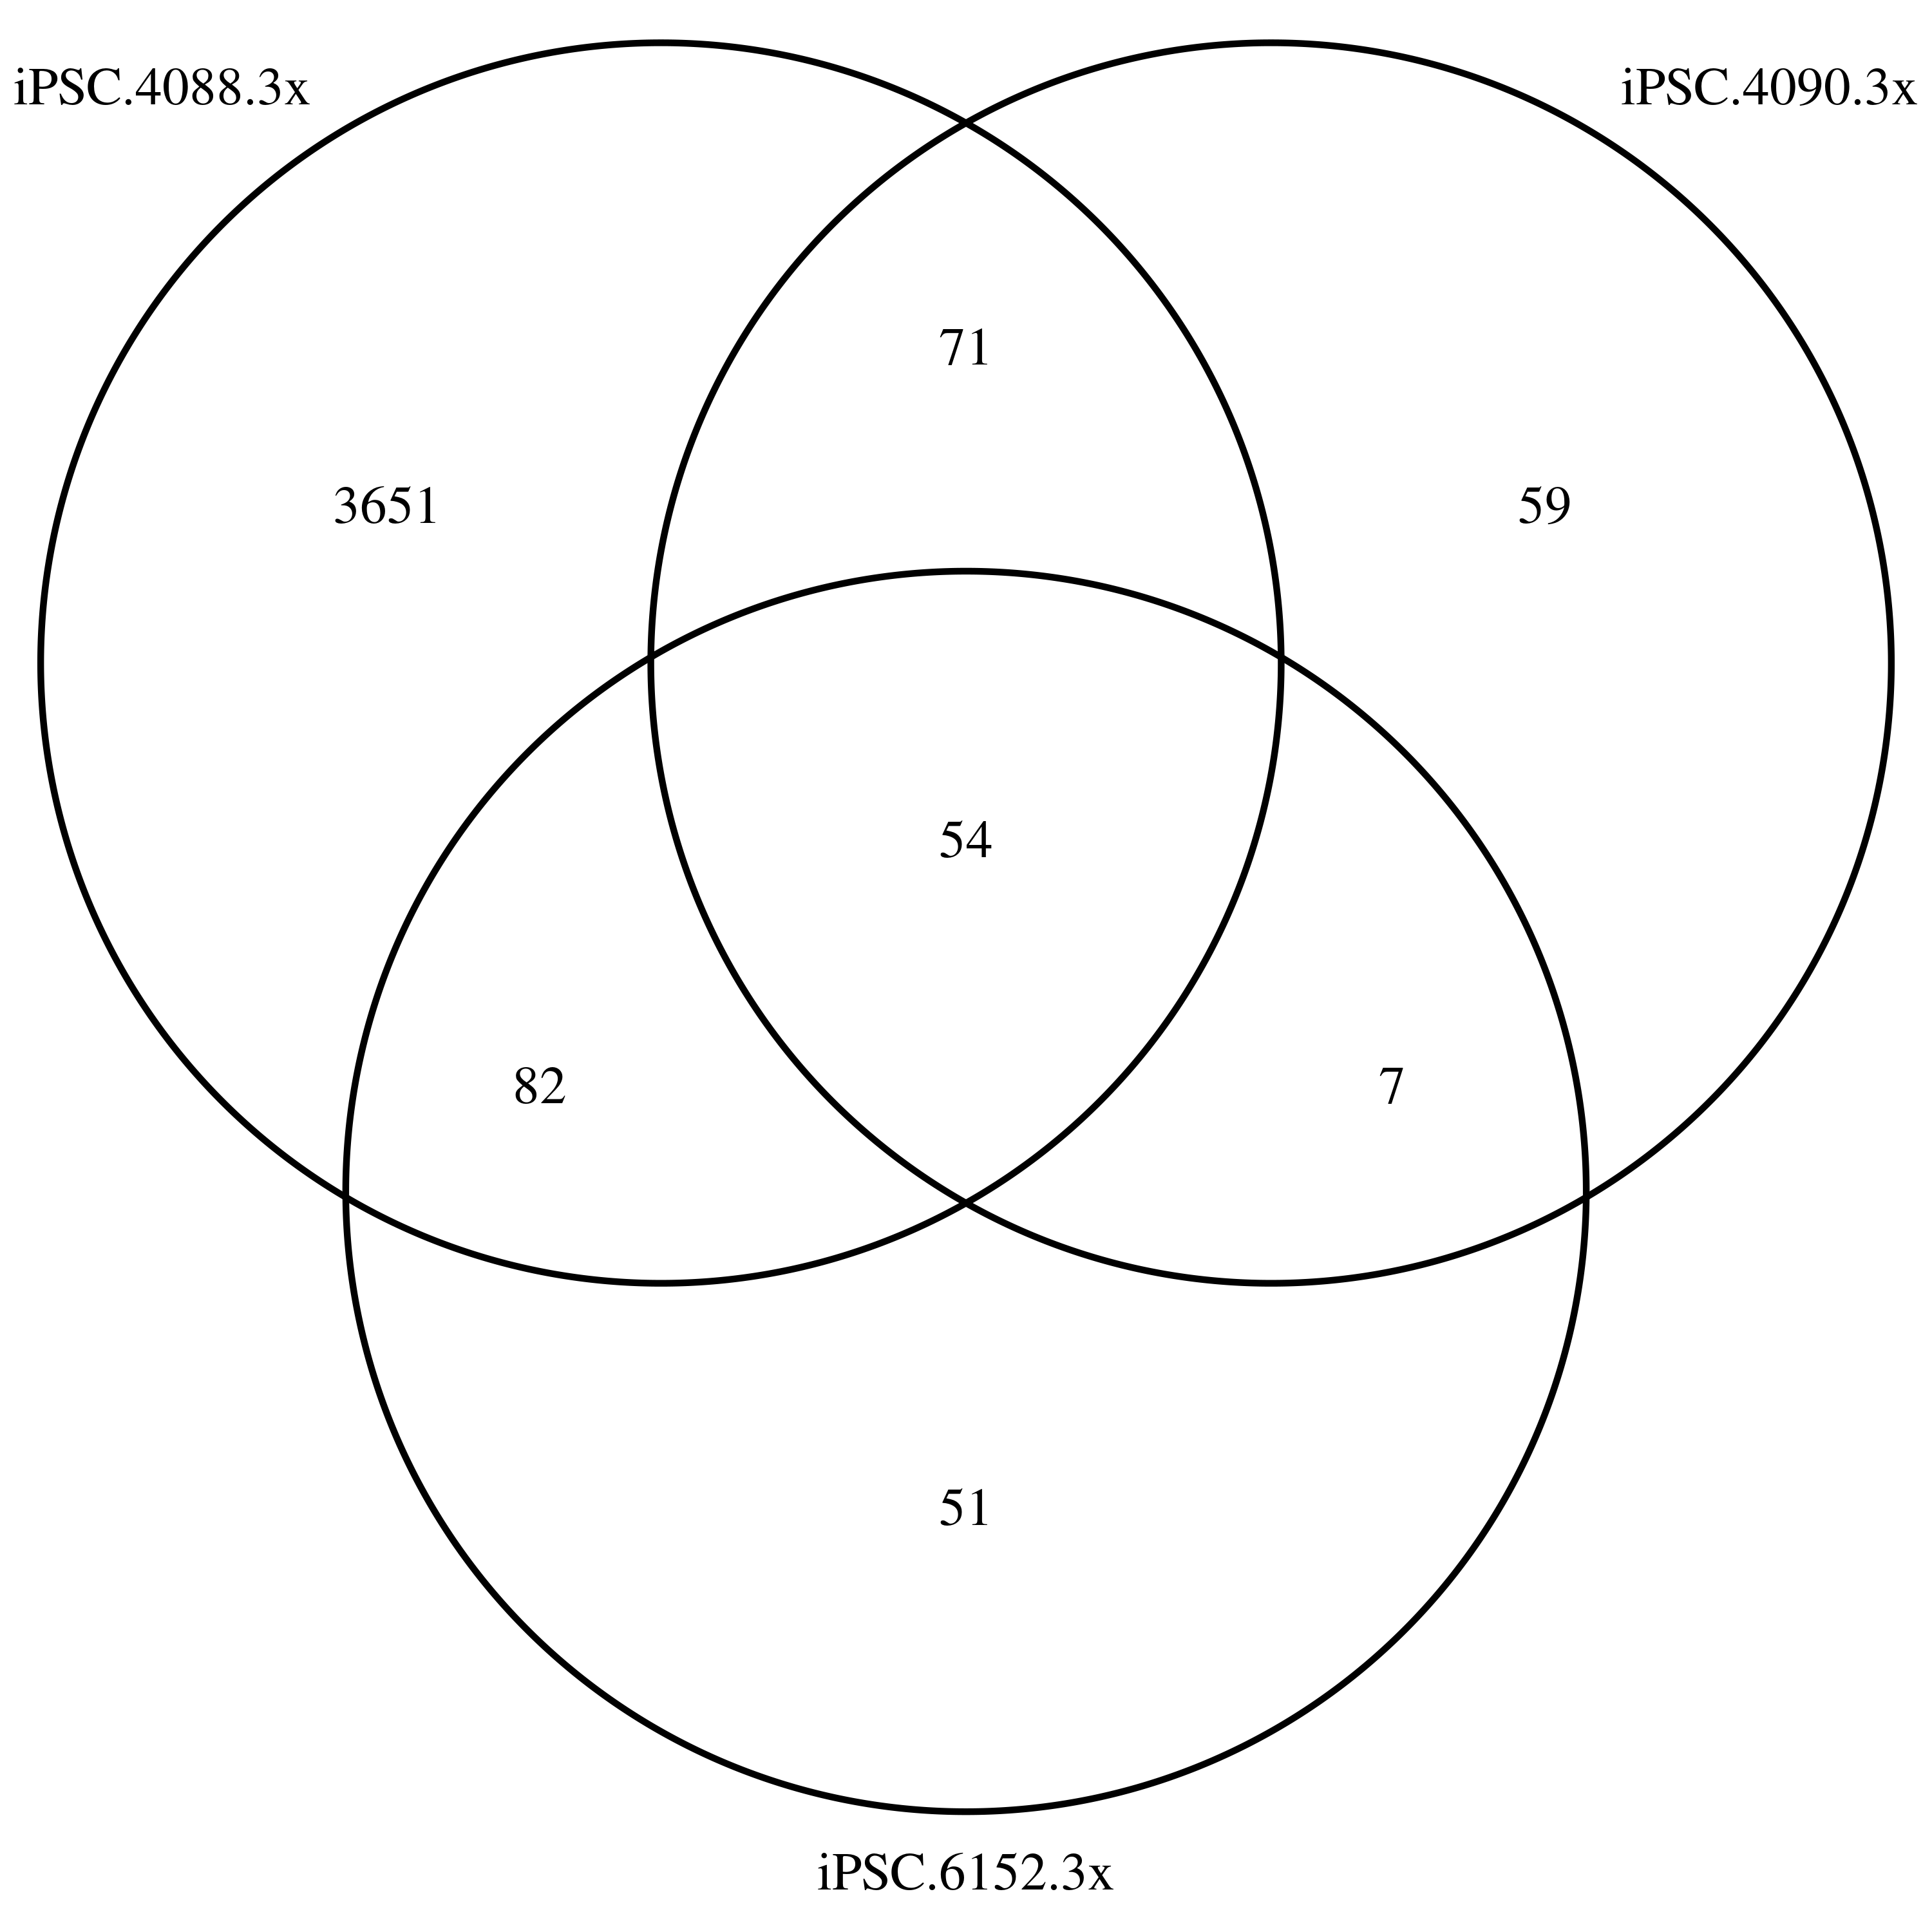
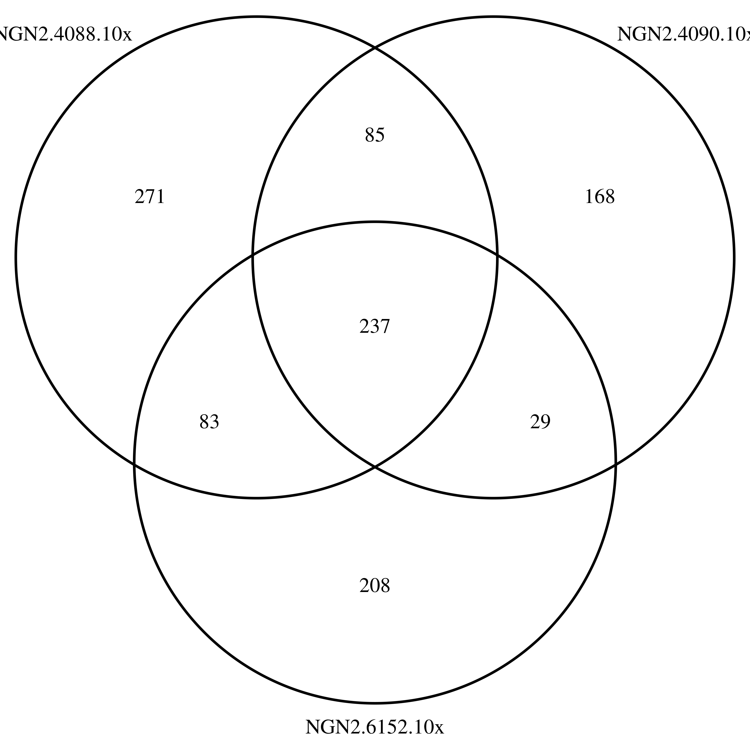
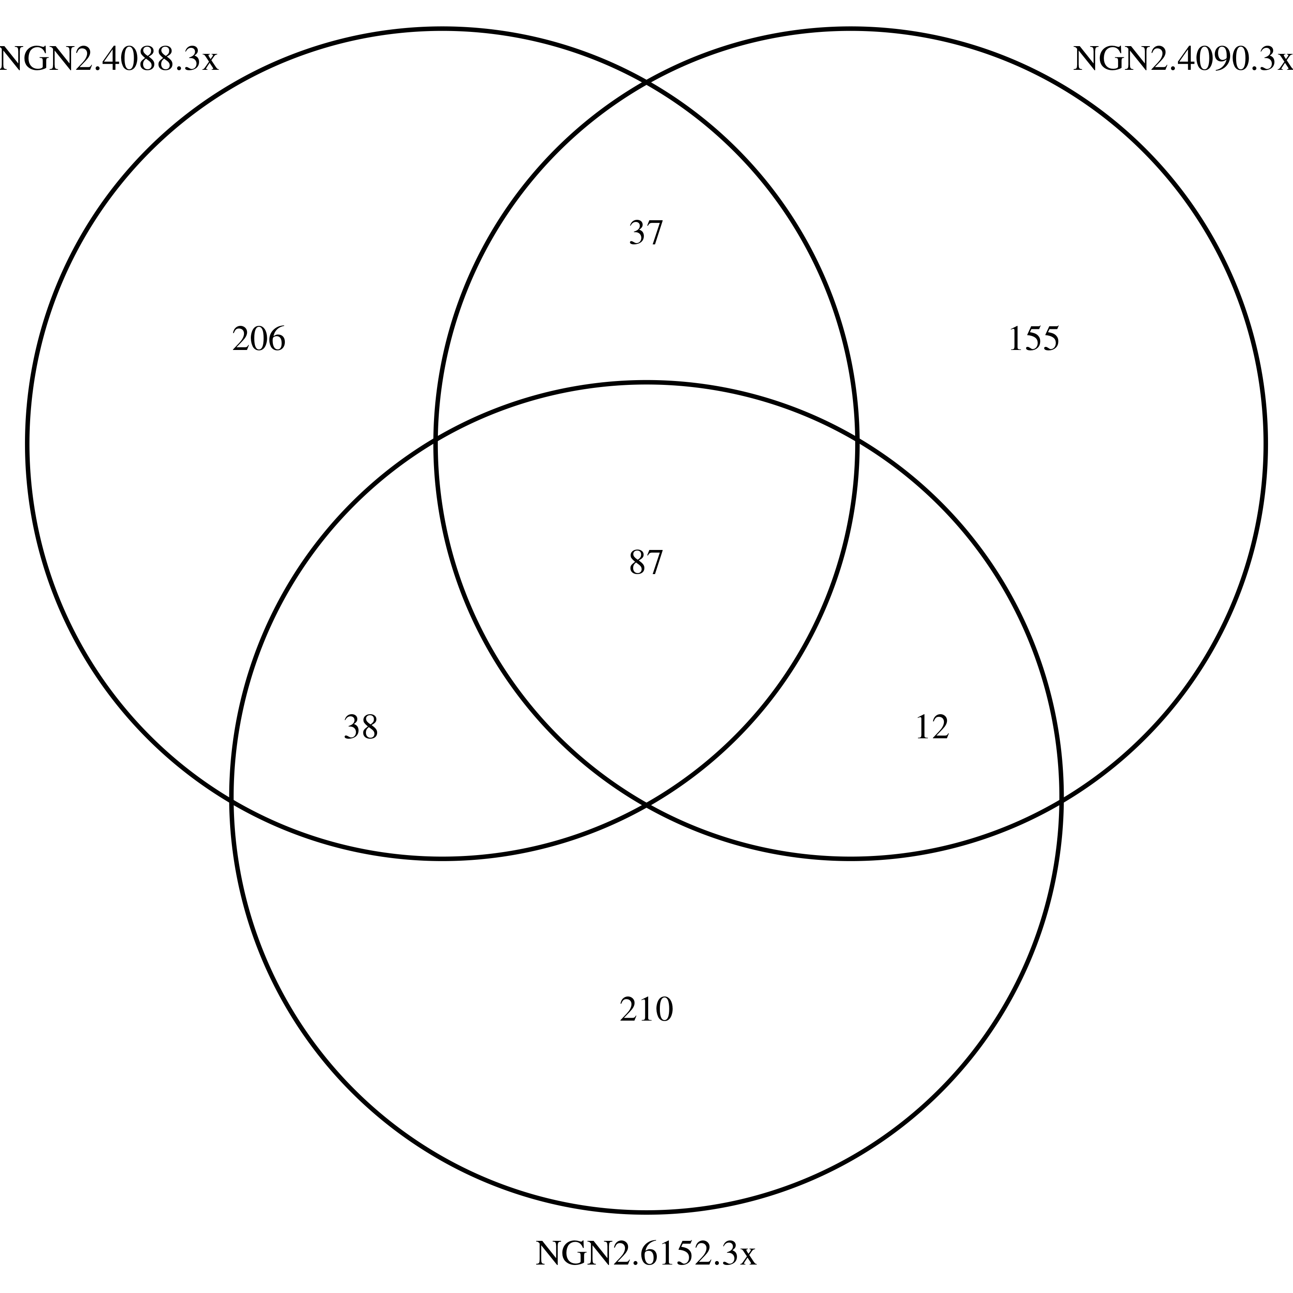
Venn

Slide 14
Sample similarity from Gene Expression
Expression heatmap for iPSC
Expression heatmap for NGN2

Slide 15

DSG and dPSI in eoi
Updated dPSI from leafcutter
dPSI from majiq
leafcutter majiq merged

Slide 16
DSG and dPSI in eoi
Updated dPSI from leafcutter
dPSI from majiq
leafcutter majiq merged

